Slide 1
L4 : Virtual Private Network(VPN)
Prepared by
AVITA KATAL
Assistant Professor
Systemics Cluster
SoCS,UPES

Slide 2
Contents
1. What is VPN?
2. Categories of VPN
3. Types of VPN
3.1. Remote User VPN
3.2. Intranet VPN
3.3. Extranet VPN
4. Components of VPN
4.1. security
4.2. Appliances
4.3. Management
5. Benefits of VPN
6. When to use VPN?

Slide 3
What is VPN?
VPN is a private point-to-point connection between two machines or networks over a shared or public network such as the internet.
A Virtual Private Network is a combination of software and hardware.
VPN (Virtual Private Network) technology, can be use in organization to extend its safe encrypted connection over less secure internet to connect remote users, branch offices, and partner private, internal network.
VPN turn the Internet into a simulated private WAN.
Notes:
Virtual. Virtual means not real or in a different state of being. In a VPN, private communication between two or more devices is achieved through a public network the Internet. Therefore, the communication is virtually but not physically there.
Private. Private means to keep something a secret from the general public. Although those two devices are communicating with each other in a public environment, there is no third party who can interrupt this communication or receive any data that is exchanged between them.
Network. A network consists of two or more devices that can freely and electronically communicate with each other via cables and wire. A VPN is a network. It can transmit information over long distances effectively and efficiently.
.

Slide 4
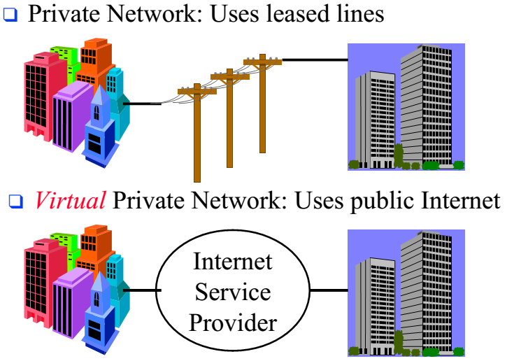
VPN contd…
Notes:
Virtual Private Network, is defined as a network that uses public network paths but maintains the security and protection of private networks. For example, Delta Company has two locations, one in Los Angeles, CA (A) and Las Vegas, Nevada (B). In order for both locations to communicate efficiently, Delta Company has the choice to set up private lines between the two locations. Although private lines would restrict public access and extend the use of their bandwidth, it will cost Delta Company a great deal of money since they would have to purchase the communication lines per mile. The more viable option is to implement a VPN. Delta Company can hook their communication lines with a local ISP in both cities. The ISP would act as a middleman, connecting the two locations. This would create an affordable small area network for Delta Company

Slide 5
2. Categories of VPN’s
VPNs were are broken into 4 categories-
Trusted VPN
A customer “trusted” the leased circuits of a service provider and used it to communicate without interruption. Although it is “trusted” it is not secured.
Secure VPN:
With security becoming more of an issue for users, encryption and decryption was used on both ends to safeguard the information passed to and fro. This ensured the security needed to satisfy corporations, customers, and providers.
Hybrid VPN:
A mix of a secure and trusted VPN. A customer controls the secure parts of the VPN while the provider, such as an ISP, guarantees the trusted aspect.
Provider-provisioned VPN:
A VPN that is administered by a service provider.

Slide 6
3. Types of Vpn
There are currently three types of VPN in use:
3.1. Remote access VPN
3.2. Intranet VPN
3.3. Extranet VPN.

Slide 7
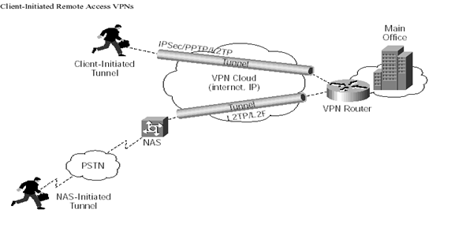
3.1. Remote Access VPn
Notes:
Enables mobile users to establish a connection to an organization server by using the infrastructure provided by an ISP (Internet Services Provider). Remote access VPN allows users to connect to their corporate intranets or extranets wherever or whenever is needed. Users have access to all the resources on the organization’s network as if they are physically located in organization. The user connects to a local ISP that supports VPN using plain old telephone services (POTS), integrated services digital network (ISDN), digital subscriber line (DSL), etc. The VPN device at the ISP accepts the user’s login, then establishes the tunnel to the VPN device at the organization’s office and finally begins forwarding packets over the Internet.
Remote access VPN offers advantages such as:
Reduced capital costs associated with modem and terminal server equipment
Greater scalability and easy to add new users
Reduced long-distance telecommunications costs, nationwide toll-free 800 number is no longer needed to connect to the organization’s modems

Slide 8
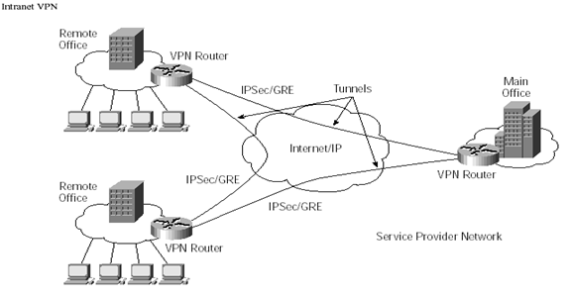
3.2. Intranet vpn
Notes:
Intranet VPNs, provides virtual circuits between organization offices over the Internet (see figure). They are built using the Internet, service provider IP, Frame Relay, or ATM networks. An IP WAN infrastructure uses IPSec or GRE to create secure traffic tunnels across the network.
Benefits of an intranet VPN include the following:
Reduced WAN bandwidth costs, efficient use of WAN bandwidth
Flexible topologies
Congestion avoidance with the use of bandwidth management traffic shaping

Slide 9
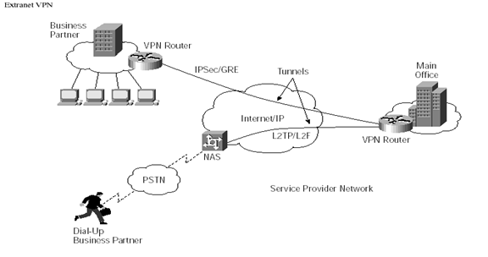
3.3 Extranet VPN
Notes:
The concept of setting up extranet VPNs are the same as intranet VPN. The only difference is the users. Extranet VPN are built for users such as customers, suppliers, or different organizations over the Internet.

Slide 10
4. Components of VPN
Security:Companies need to keep their VPNs secure from tampering and unauthorized users. Some examples of technologies that VPN’s use are; IP Security (IPSec), Point-to-Point Tunneling Protocol (PPTP), Layer 2 Tunneling Protocol and Multiprotocol Label Switching (MPLS) along with Data Encryption Standard (DES), and others to manage security.
Appliances: Intrusion detection firewalls
Management: Managing security policies, access allowances, and traffic management

Slide 11
4.1. Security
Point-to-Point Protocol (PPP)
PPTP uses Point-to-Point Protocol (PPP) to provide remote access that can be tunneled through the Internet to a desired site.
Tunneling allows senders to encapsulate their data in IP packets that hide the routing and switching infrastructure of the Internet from both senders and receivers to ensure data security against unwanted viewers, or hackers.
PPTP is designed to run on the Network layer of the Open systems interconnection (OSI).
It uses a voluntary tunneling method, where connection is only established when the individual user request to logon to the server.

Slide 12
4.1 security contd…
Layer Two Tunneling Protocol (L2TP)
Layer Two Tunneling Protocol (L2TP) exists at the data link layer of the OSI model. L2TP is a combination of the PPTP and Layer two Forwarding (L2F).
L2TP uses a compulsory tunneling method, where a tunnel is created without any action from the user, and without allowing the user to choose a tunnel.
A L2TP tunnel is dynamically established to a predetermined end-point based on the Network Access Server (NAS) negotiation with a policy server and the configured profile.
L2TP also uses IPSec for computer-level encryption and data authentication.

Slide 13
4.1 security contd…
IPSec
IPSec uses data encryption standard (DES) and other algorithms for encrypting data, public-key cryptography to guarantee the identities of the two parties to avoid man-in-the-middle attack, and digital certificates for validating public keys.
It sits between IP at the network layer and TCP/UDP at the transport layer.
Both parties negotiated the encryption technique and the key before data is transferred.
IPSec can operate in either transport mode or tunnel mode.
In tunnel model, intruders can only see where the end points of the tunnel are, but not the destinations of the packet and the sources. IPSec encrypts the whole packet and adds a new IP packet that contains the encrypted packet.
In Transport mode IPSec leaves the IP packet header unchanged and only encrypts the IP payload to ease the transmission through the Internet.

Slide 14
4.1 security contd…
Multiprotocol Label Switching (MPLS)
Multiprotocol Label Switching (MPLS) uses a label swapping forwarding structure.
When the packets enter the MPLS, it is assigned a local label and an outbound interface based on the local forwarding decision.
The forwarding decision is based on the incoming label, where it determines the next interface and next hop label.
The MPLS uses a look up table to create end-to-end transmission pathway through the network for each packet.

Slide 15
4.1 security contd…
Packet authentication
Packet authentication prevents data from being viewed, intercepted, or modified by unauthorized users.
Packet authentication applies header to the IP packet to ensure its integrity. When the receiving end gets the packet, it needs to check for the header for matching packet and to see if the packet has any error.
User authentication
User authentication is used to determine authorized users and unauthorized users. It is necessary to verify the identity of users that are trying to access resources from the enterprise network before they are given the access.
User authentication also determines the access levels; data retrieved or viewed by the users, and grant permission to certain areas of the resources from the enterprise.

Slide 16
4.2. Appliances
Firewalls monitors traffic crossing network parameter, and protect enterprises from unauthorized access.
The organization should design a network that has a firewall in place on every network connection between the organization and the Internet.
Two commonly used types of firewalls are
Packet-level firewalls and
Application-level firewalls.

Slide 17
4.2. Appliances contd…
Packet level Firewalls
Packet-level firewall checks the source and destination address of every packet that is trying to passes through the network.
Packet-level firewall only lets the user in and out of the organization’s network only if the users have an acceptable packet with the correspondent source and destination address.
The packet is checked individually through their TCP port ID and IP address, so that it knows where the packet is heading.
Disadvantage of packet-level firewall is that it does not check the packet contents, or why they are being transmitted, and resources that are not disabled are available to all the users.

Slide 18
4.2. Appliances contd…
Application level Firewall
Application-level firewall acts as a host computer between the organization’s network and the Internet.
Users who want to access the organization’s network must first log in to the application-level firewall and only allow the information they are authorized for.
Advantages for using application-level firewall are: users access level control, and resources authorization level.
Only resources that are authorized are accessible.
In contrast, the user will have to remember extra set of passwords when they try to login through the Internet.

Slide 19
4.3. Management
VPN’s need to be flexible to a companies management, some companies chooses to manage all deployment and daily operation of their VPN, while others might choose to outsource it to service providers.

Slide 20
5. Benefits of vpn
VPN’s Benefit a company in the following ways
Extends Geographic Connectivity.
Boosts Employee Productivity
Improves Internet Security
Scales Easily
Notes:
VPN’s Benefit a company in the following ways
Extends Geographic Connectivity- a VPN connects remote workers to central resources, making it easier to set up global operations.
Boosts Employee Productivity- A VPN solution enables telecommuters to boost their productivity by 22% - 45% (Gallup Organization and Opinion Research) by eliminating time-consuming commutes and by creating uninterrupted time for focused work.
Improves Internet Security – An always-on broadband connection to the Internet makes a network vulnerable to hacker attacks. Many VPN solutions include additional security measures, such as firewalls and anti-virus checks to counteract the different types of network security threats.
Scales Easily – A VPN allows companies to utilize the remote access infrastructure within ISPs. Therefore, companies are able to add a virtually unlimited amount of capacity without adding significant infrastructure.

Slide 21
6. When to use vpn?
Even though VPN’s are a cheaper way of having remote users connect to a company’s network over the Internet there are still costs associated with implementing the VPN.
Some of the typical costs include hardware, ISP subscription fees, network upgrading costs and end user support costs.
These costs aren’t standard they vary depending on many factors, some of which include, size or corporation, number of remote users, type of network systems already in place and Internet Service Provider source.

Slide 22
6. When to use vpn? ConTd…
Decision makers must decide whether to develop their VPN solution in house or to outsource to a total service provider. There are a few ways to approach this topic;
In House Implementation- companies decide that for their needs an in-house solution is all they need. These companies would rather set up individual tunnels and devices one at a time and once this is established the company can have their own IT staff take care of the monitoring and upkeep.
Outsourced Implementation- companies can choose to outsource if they are large scaled or lack the IT staff to fully implement an in house VPN. When a company outsources the service provider usually designs the VPN and manages it on the company’s behalf.
Middle Ground Implementation- Some companies would rather have a service provider install the VPN but have their IT staff monitor the specifics such as tunnel traffic. This type of implementation is a compromise between a company and the service provider.

Slide 23
Quality of Service
After Implementation the company must make sure that it has adequate support for its end users. That’s where quality of service comes in.
QoS (Quality of Service) aims to ensure that your mission critical traffic has acceptable performance.
In the real world where bandwidth is limited and diverse applications from videoconferencing to ERP database lookups must all strive for scarce resources, QoS becomes a vital tool to ensure that all applications can coexist and function at acceptable levels of performance.

